Slide 1
advoclik
get paid for sharing the products you love

Slide 2
problem
The most effective marketing comes from consumer advocates
Brands can’t find and reward consumers who are their biggest supporters
Consumers can’t get rewarded for sharing the brands they love

Slide 3
solution
advoclik: Google AdWords for advocate marketing

Slide 4
solution
Pay individuals for sharing products they already love with their friends
Allow brands to purchase advocate referrals per click a la AdWords
A minimal, friction-free way to advertise via word of mouth

Slide 5
demo
Alpha stage prototype

Slide 6
market
What is our initial market?
What is our ultimate market?
Social network ad spending is expected to hit $30B globally in 2016¹
An interesting fact about advocate marketing oooooh aaaaaah (X percent of people increasing adv. Marketing maybe?)
The average Facebook user has over 300 friends on the site, and brings in approximately $10 in ad revenue annually²
¹ http://www.emarketer.com/Article/Social-Network-Ad-Spending-Hit-2368-Billion-Worldwide-2015/1012357
² http://www.pewresearch.org/fact-tank/2014/02/03/6-new-facts-about-facebook/ http://qz.com/335473/heres-how-much-money-you-made-for-facebook-last-year/

Slide 7

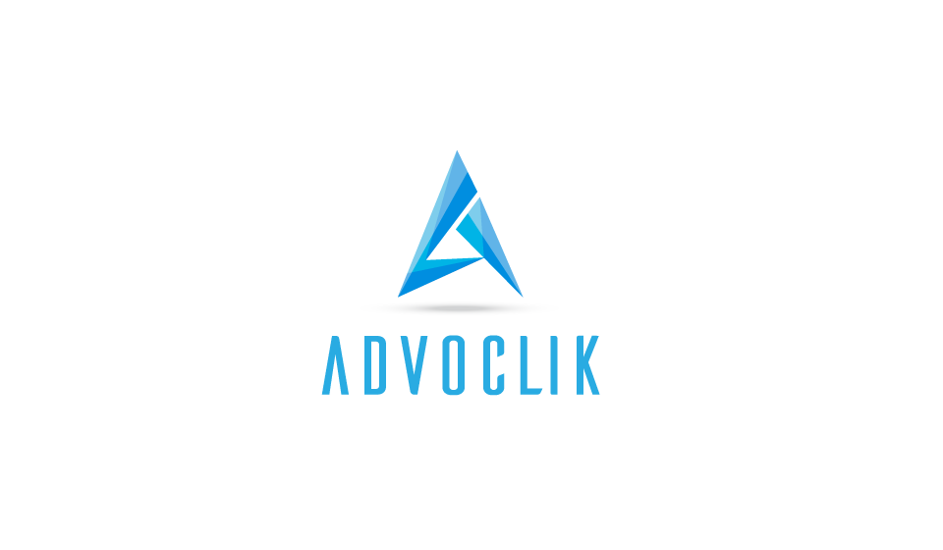


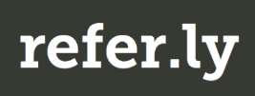

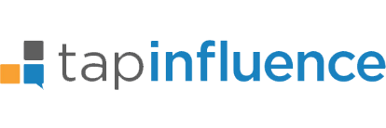


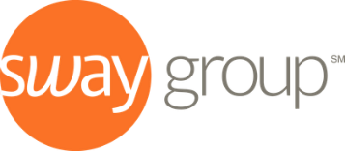

competition
Pay for positive social media content
Provide financial rewards to consumer advocates
Encourage consumer advocates
Match brands with famous influencers

Slide 8
next steps
Continue building out prototype to ensure secure customer log-in, connection with social media accounts, and third-party payment
Get first brand partners – target mid-size chains in the Chicago area that already do a lot of Facebook advertising (e.g., Toppers Pizza)
Open landing page and begin getting beta users

